Slide 1
Analyzing Health Equity Using Household Survey Data
Lecture 13
Explaining Socioeconomic-Related Health Inequality:
Decomposition of the Concentration Index
Notes:
1. In the previous lecture we learned how to use Oaxaca-type decomposition to explain the difference between two groups in the mean of some outcome variable of interest, which could be health or health care. By defining groups by socioeconomic status and using the method above, we can explain socioeconomic-related inequality in health or health care. But the degree of inequality captured is inevitably limited, given that group differences are examined. Measurement and explanation of inequality in health or health care across the entire distribution of some measure of socioeconomic status would be preferable. In lecture 8 we introduced the concentration index as a measure of socioeconomic-related inequality in health or health care. In this lecture we will explain how such inequality can be explained through decomposition of the concentration index.

Slide 2
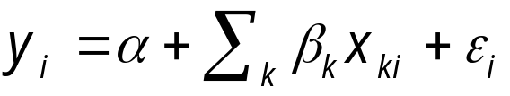
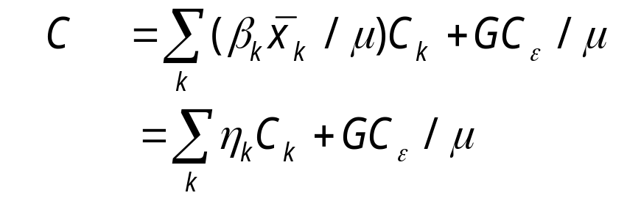

Decomposition of the Concentration Index
  For any linear additive explanatory model of ‘health’ (y) such as :
  the concentration index of y can be decomposed (Wagstaff et al 2003):
  where μ is the mean of y, is the mean of x_{k}, C_{k} is the concentration index for x_{k} , GC_{ε} is the generalized concentration index for the error term, and η_{κ} is the elasticity of y with respect to x_{k} .
Notes:
For ease of exposition, we will refer to any health sector variable, such as health or health care use or payments, as “health” and to any (continuous/ordinal) measure of socioeconomic status as “income.”
Wagstaff, van Doorslaer, and Watanabe (2003) demonstrate that the health concentration index can be decomposed into the contributions of individual factors to income-related health inequality, in which each contribution is the product of the sensitivity of heath with respect to that factor (the elasticity) and the degree of income-related inequality in that factor (the respective concentration index).
That is, the concentration index for the health variable of interest, y, can be written as a weighted sum of the concentration indices of the k regressors, where the weight for xk is the elasticity of y with respect to xk .
The residual component—captured by the last term—reflects the income-related inequality in health that is not explained by systematic variation in the regressors by income, which should approach zero for a well-specified model.

Slide 3
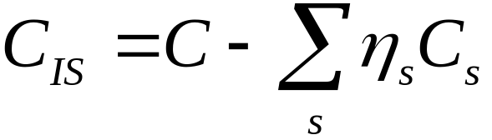
Age-sex standardization through decomposition
  The indirectly standardized concentration index (C_{IS}) can be obtained by subtracting the contributions of all standardizing variables (s) from the unstandardized concentration index (Van Doorslaer et al, 2004):
Notes:
As discussed in chapter 5, one is often interested in income-related inequality in a health sector variable after standardizing for correlates of income, such as age and gender.
To assess equity in the distribution of health care (see chapter 15), it is also necessary to standardize for differences in “need.”
The regression decomposition method is a convenient way of making such a standardization. One simply needs to deduct the contributions of the standardizing variables (included in the regression along with others) from the total concentration index.
Van Doorslaer, Koolman, and Jones (2004) have demonstrated that this is equivalent to the two-step approach to indirect standardization discussed in chapter 5.
Application of this approach to the measurement of inequity in health care use is discussed in chapter 15.

Slide 4
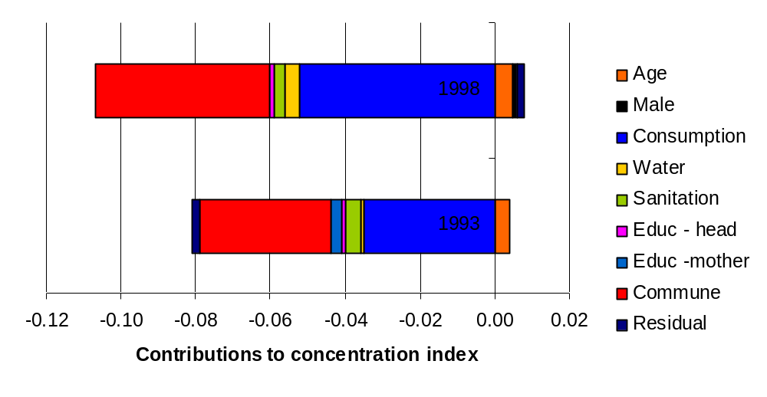
Decomposition of Concentration Index for Height-for-Age z-Scores of kids<10 Years, Vietnam
Aggregate contributions
Notes:
Wagstaff, van Doorslaer, and Watanabe (2003) use the decomposition method to decompose income-related inequality in child malnutrition in Vietnam in 1993 and 1998.
As in lectures 10 and 12 , malnutrition is measured by the height-for-age z-scores (HAZ) of children younger than 10 years of age, and the measure of living standards is household consumption per capita. The z-scores are multiplied by –1 such that a greater value indicates more malnourishment. The specification of the regression model is very similar to that used in chapters 10 and 12 . Here we include commune fixed effects to pick commune-level determinants of nutritional status.
A summary of the results is presented in the chart. The contribution of each factor, that is the product of its elasticity and its concentration index, is shown.
The overall concentration indices are -0077 and -0.099 in 1993 and 1998 respectively, indicating that there was inequality in HAZ to the disadvantage of the poor in each year and that this inequality increased over time. Most of the contributions are negative, with offsetting effects through age and gender only.
In each year, most of the consumption-related inequality in HAZ is explained by the direct effect of household consumption and by commune-level unobservable correlates of both malnutrition and consumption.
Standard errors for these contributions can be obtained by bootstrapping (van Doorslaer and Koolman, 2004).

Slide 5

Magnitudes of contributions
  The contribution of variable x_{k} to income-related health inequality is given by
  and is larger:
  The greater is the elasticity of health in relation to the variable (η_{κ})
  The more unequally is the variable distributed in relation to income (C_{k})
Notes:
From the previous chart it is not possible to identify why the contributions of some factors are larger that those of others. Is it because health is more sensitive to those factors, or because there is greater income-related inequality in them? But the decomposition does make it possible to distinguish between these cases.
Here we are always referring to absolute contributions (magnitudes).

Slide 6
Detailed decomposition of concentration index for HAZ-Scores in Vietnam
 | 1993 |  |  |  |  | 1998
 | Elasticities |  | CIs | Contrib-utions |  | Elasticities | CIs | Contrib-utions
Child’s age (in months) | 1.137 |  | 0.020 | 0.023 |  | 1.630 | 0.018 | 0.030
Child’s age squared | –0.634 |  | 0.030 | –0.019 |  | –0.880 | 0.028 | –0.025
Child = male | 0.022 |  | 0.003 | 0.000 |  | 0.045 | 0.014 | 0.001
(log)household consumption p.c. | –0.936 |  | 0.038 | –0.035 |  | –1.288 | 0.040 | –0.052
Safe drinking water | –0.003 |  | 0.312 | –0.001 |  | –0.017 | 0.256 | –0.004
Satisfactory sanitation | –0.009 |  | 0.468 | –0.004 |  | –0.006 | 0.508 | –0.003
Years schooling household head | –0.017 |  | 0.065 | –0.001 |  | –0.015 | 0.094 | –0.001
Years schooling mother | –0.037 |  | 0.075 | –0.003 |  | –0.003 | 0.108 | 0.000
Fixed commune effects | 1.477 |  | –0.024 | –0.035 |  | 1.534 | 0.031 | –0.047
“Residual” |  |  |  | –0.002 |  |  |  | 0.002
Total |  |  |  | –0.077 |  |  |  | –0.099
Notes:
Here we show the detailed decomposition results from Wagstaff et al (2003) for the same example presented above.
The entries in each column give, for each year, the elasticity of HAZ with respect to each factor, the concentration index for each factor, and the total contribution of each factor to the HAZ concentration index.
The large elasticities of HAZ with respect to consumption and commune fixed effects indicate that these factors are responsible for their large contribution to the HAZ concentration index. In contrast, there is a great deal of consumption-related inequality in access to both safe drinking water and satisfactory sanitation, but there is little sensitivity of HAZ to variation in these factors, and so they make little contribution to the HAZ concentration index.

Slide 7
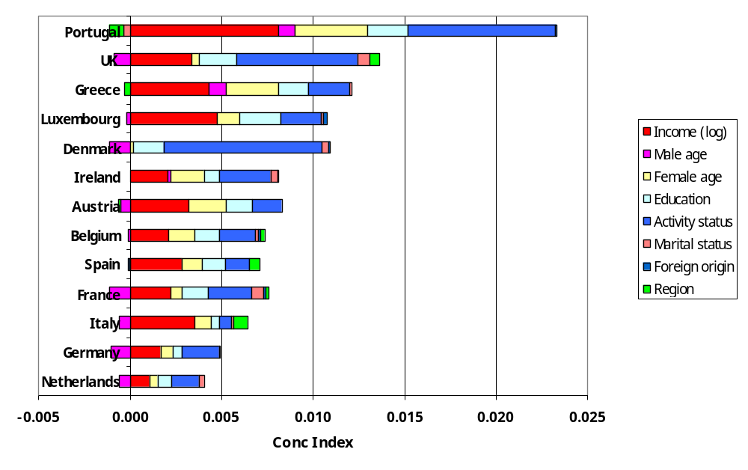
Decomposition of income-related health inequality in Europe
Notes:
The decomposition method has also been used to explain income-related health inequality in Europe. Source: van Doorslaer, E., and X. Koolman. 2004. “Explaining the Differences in Income-Related Health Inequalities across European Countries.” Health Economics 13(7): 609–28.
Health is measured by self-assessed health.
Data are from the European Household Panel Survey.
Countries are ranked by the magnitude of the total concentration index from the most to least unequal.
In the chart we show the total contribution of each factor.
In most countries, the largest contribution is from the direct effect of income, followed by the contribution of labour market activity status (unemployed, employed, retired, inactive) , and then education.
In southern European countries regional disparities also paly an important role in contributing to income-related health ineqauality.
Relative to the reference category, age differences for females contributes positively to the inequality but age differences for males negatively.

Slide 8
Decomposition of change in the concentration index - Oaxaca
Applying Oaxaca-type decomposition to the difference
between the concentration indices of two populations:
i.e. a sum of the differences in the
- CIs for determinants k weighted by their elasticities
- elasticities weighted by their respective CIs
- generalised CIs of the residuals
Of course, the weights could be reversed
Notes:
Wagstaff, van Doorslaer and Watanabe (2003) also suggested using the decomposition framework to explain change in the degree of income-related health inequality over time. That is, change in the concentration index. One way to do this is by applying the Oaxaca method again.
where t indicates time period and Δ denotes first differences. But the same method could be applied to differences at a point in time between two populations e.g. countries.

Slide 9
Decomposition of increase in inequality in child HAZ-scores in Vietnam 1993-98
Notes:
Again this is taken from Wagstaff et al (2003) applying the Oaxaca method of decomposition of the difference in concentration indices for HAZ scores between 1993 and 1998.
As we saw earlier, the concentration index changed from -0.077 in 1993 to -0.099 in 1998 indicating increased inequality to the advantage of the better-off.
The first bar shows the total contribution of each factor to the increased inequality in HAZ. The main contribuiting factor is the direct effect of household (hh) consumption (income). There are also large effects from the commune fixed effects (yellow), father’s education (black) and access to sanitation (green).
The second and third bars divide the total contribution of each factor into the effect through the change in the respective elasticity and the change in the concentration index respectively. It is obvious that changes in the distribution of factors relative to hhold consumption, and not changes in the correlation of factors with HAZ, are maionly responsible for the increased consumption-related inequality in HAZ. The largest contribution is from the increases inequality in hhold consumption, that is an increase in the Gini coefficient. Father’s education, and access to safe drinking water and sanitation have also become more unequally distributed and contributed to the increase consumption-related inequality in HAZ.

Slide 10
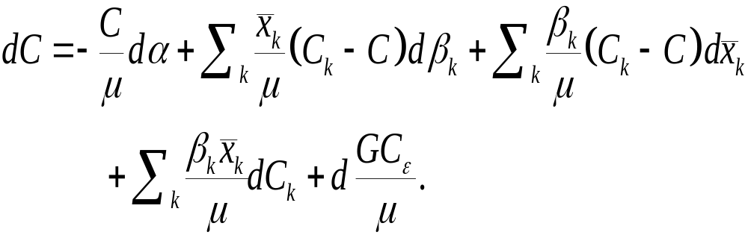
Decomposition of change in the concentration index – total differential
To identify the contribution of the change in each
component of the elasticity, take the total differential
of the decomposed CI:
Notes:
The Oaxaca-type method to decomposing change in the concentration index allows distinction between changes in inequality in the determinants of health, on the one hand, and changes in the elasticities of health with respect to these determinants, on the other. But it does not allow one to disentangle changes going on within the elasticities.
To address this limitation, Wagstaff, van Doorslaer, and Watanabe (2003) consider the total differential of the decomposed concentration index (see slide 2), allowing for changes in turn in the regression parameters, the means, and the concentration indices of the regressors.
Note that the effect on C of a change in β_k, or in mean x_k, depends on whether x_k is more unequally or less unequally distributed than y (that is, the size of the respective CI relative to the CI of y) . This reflects two separate channels of influence—the direct effect of the change in β_k (or mean x_k) on C and the indirect effect operating through mean y.
The fourth terms tells us that an increase in inequality in x_k (i.e., Ck) will increase the degree of inequality in y. The impact is an increasing function of β_k and mean x_k and a decreasing function of mean y.

Slide 11
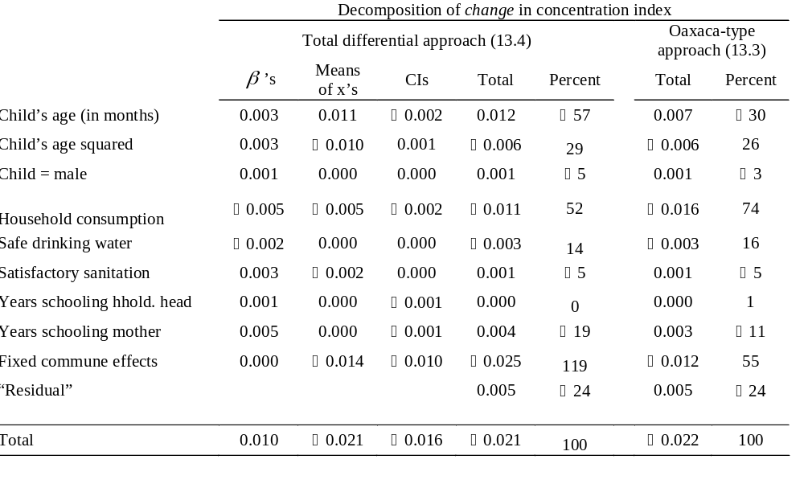
Decomposition of Change in HAZ Concentration Index of kids <10 Years, Vietnam 1993–98
Notes:
Here we show the results from Wagstaff et al (2003) using both methods to decompose the change in HAZ concntration index between 1993 and 1998 in Vietnam.
Estimates of the percentage contribution of each determinant to the total change in C (third from last and last columns) are broadly similar across the two methods, with some important discrepancies. The Oaxaca-type method attributes more of the change to household consumption, whereas the differential approach gives more weight to changes occurring at the commune level.
From the individual components of the total differential method (columns 2–4), we see that whereas changes in the means and concentration indices of the determinants of malnutrition have, on balance, tended to increase income-related inequality in HAZ, the opposite appears to be true of changes in the regression coefficients.

Slide 12
Oaxaca method can be used to explain cross-country differences in income-related health inequality
Netherlands has lowest income-related health inequality
Define ‘excess’ inequality of each country relative to the Netherlands
Compute contribution of each factor to ‘excess’ income-related health inequality

Slide 13
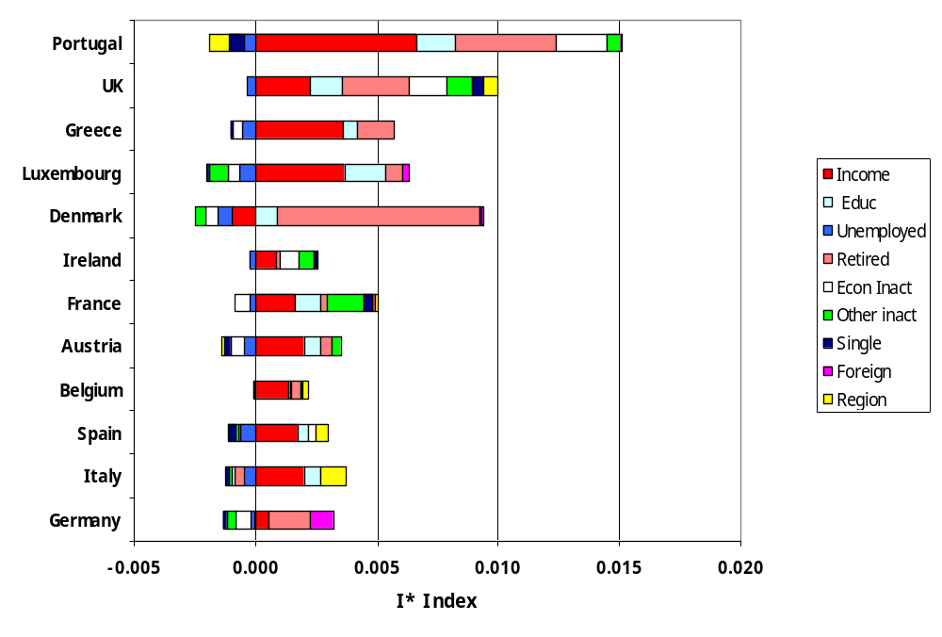
Contribution of each factor to ‘excess’ income-related health inequality relative to the Netherlands
Notes:
These results are taken from van Doorslaer and Koolman (2004). They show the total contribution of each factor to the income-related health inequality in each country over and above that observed in the Netherlands. This total contribution is the sum of the differential health elasticity of the factor (weighted by a concentration index) and the differential concentration index (weighted by the other elasticity), as in the Oaxaca method given above.
For most countries, the distribution of income and the sensitivity of health to makes the greatest contribution to the greater income-related health inequality relative to the Netherlands. Cross-country differences in in the correlation of retirement with health and/or income also make a large contribution. A smaller but consistent effect comes from the correlations of education with health and/or income.

Slide 14
Conclusions
Decomposition is useful explanatory tool for partitioning inequality
Contributions can be further decomposed into elasticity of health and inequality of determinants
Oaxaca-type decomposition useful for explaining differences or changes
Limitations:
  Linearity of underlying model
  Explanatory model usually does not allow for causal interpretation
Notes:
1. The decomposition method relies on linearity of the underlying regression model. When the model is inherently nonlinear, it may be possible to base the decomposition on a linear approximation to the model. Van Doorslaer, Koolman, and Jones (2004) have used the “partial effects” representation of nonlinear count models to assess the degree of horizontal inequity in health care use in 12 European countries. This representation has the advantage of being a linear additive model of actual utilization, but it holds only by approximation, and the decomposition is not unique but depends on the values at which partial effects are calculated. The approach is presented and discussed in lecture 15.

